Slide 1

Android SMIL Messenger
PRESENTED BY:
BENJAMIN B.
BRIAN S.
CORRY D.
CURTIS L.
JASON N.
SPENCER E.

Slide 2
Background
Mobile SMIL in the Cloud -- SMIL (pronounced "smile")
  Synchronized Multimedia Integration Language
  XML markup language for describing multimedia presentations
  Defines markup for timing, layout, audio, and visual presentations
  The SMIL language supports displaying media such as
    Text
    Image
    Audio
    Video
  timing controls
    begin time
    end time
    duration
Currently, there are some SMIL players available
  Realplayer
  Quicktime
  Windows Media player classic
However, there are very few SMIL players available for mobile devices.

Slide 3
Introduction
Business value from developing a Mobile SMIL message system
The system should consist of
  SMIL composer
    Create a new SMIL message
    Edit a SMIL message
    Save a SMIL message
    Preview a SMIL message
    Send a generated SMIL message to other mobile devices
  SMIL player
    Receiving a SMIL message
    Opening a SMIL message
    Playing a SMIL message
      Pausing the play
      Resuming the play
      Stopping the play
This system could be considered as a peer-to-peer system
Acts as the roles of both the sender and receiver.

Slide 4
Introduction (continued)
Android 2.1 or later version
Provides a multimedia messaging system
Allow users to communicate with each other
Enables the sharing of
  Audio
  Pictures
  Text
  Videos
Cloud technology
Follows SMIL specifications.

Slide 5
Group
Member | Role | Get To Know Us
Benjamin B. | Project Manager Architecture Liaison SVN Admin | AMIG Fights crime at night
Brian S. | Developer Tester | Heritage Propane
Corry D. | Applications Admin Developer | Walgreens All around nice guy Phone – 867.5309
Curtis L. | User Experience Extraordinaire Tester | Full-Time Student
Jason N. | Designer/Developer Configuration Commander | I <3 NY
Spencer E. | Senior UML Designer Developer in the Clouds | STEM Ambassador Like long walks on the Cloud

Slide 6
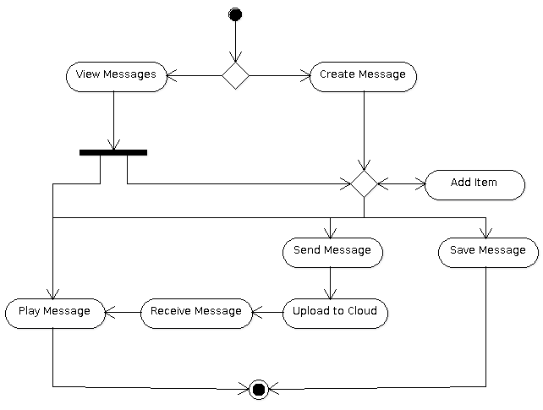
Hao, it works!
Can either create or view a message
Provides a multimedia messaging system
Allow users to communicate with each other
Enables the sharing of
  Audio
  Pictures
  Text
  Videos
Cloud technology
Follows SMIL specifications.

Slide 7
Use

Slide 8
Hoa

Slide 9
Hoa

Slide 10
Hoa

Slide 11
Hoa

Slide 12
Hoa

Slide 13
Hoa

Slide 14
Hoa

Slide 15
Hoa

Slide 16
Hoa

Slide 17
Hoa

Slide 18
Hoa

Slide 19
Hoa

Slide 20
Hoa

Slide 21
Hoa

